Slide 1
Planning for and Responding to Violence
Why Would You Wait for the Weapon to Arrive?

Slide 2
This presentation is not complete without the accompanying oral comments and discussion.
Any work product provided by Firestorm or other presenters must be read in conjunction with all guidance given by national, regional and local authorities, as well as your company’s personal counsel.
Moreover, the information given and comments made in this webinar should not be interpreted as legal advice or legal opinion.

Slide 3
AGENDA
Introduction
Workplace Violence
Prevention
Methodology
Behaviors of Concern
Critical Incident Response
Workplace Violence Solution Elements
Preparedness Self-Assessment
Q&A

Slide 4
ABOUT FIRESTORM
Firestorm Solutions, a Novume Company (Nasdaq: NVMM) is a leading crisis and risk management firm and America’s Crisis Coach®.
Firestorm has assisted clients in transforming crisis into value by responding to some of the largest and most complex crisis events as well as combining best-practice consulting with proven crisis management expertise.
Firestorm empowers clients to manage crisis and risk through assessments, audits, program development, training and advisory services using the Predict.Plan.Perform.® methodology.
Firestorm
Transforms
Crisis
Into
Value

Slide 5
Missan Eido
Principal, Firestorm
A Program Manager with an extensive track record directing Global Transformation Programs focused on Manufacturing, Systems and Process Integration, Business Architecture redesign for resiliency, Business Continuity Planning, Risk Assessment, Mitigation Testing and Training
9 Years of working as a Crisis Coach and Crisis Response Manager

Slide 6
DEFINITION
Workplace violence is any act or threat of physical violence, harassment, intimidation, or other threatening disruptive behavior that occurs at the work site. It ranges from threats and verbal abuse to physical assaults and even homicide. It can affect and involve employees, clients, customers and visitors.

Slide 7
A SAFE AND HEALTHFUL WORKPLACE OSHA 2209
A recognized hazard is a danger recognized by the employer's industry or industry in general, by the employer, or by common sense.
Appendix D: OSHA Job Safety and Health Standards, Regulations and Requirements
It is your responsibility to know what items or processes that helps you make sure that you know what you need to keep your workers safe.
Worksite Analysis
Once you have identified your existing and potential hazards, you are ready to implement the systems that prevent or control those hazards.
Hazard Prevention And Control
Evacuation Plan - establish and practice procedures for an emergency evacuation, e.g., fire, chemical/biological incidents, bomb threat; include escape procedures and routes, critical plant operations, employee accounting following an evacuation, rescue and medical duties and ways to report emergencies.
Self-Inspection Scope
Make sure you have trained your employees on every potential hazard that they could be exposed to and how to protect themselves. Then verify that they really understand what you taught them.
Training For Employees, Supervisors And Managers

Slide 8
TYPES OF WORKPLACE VIOLENCE
Criminal Intent
Customer/Client
Employee-to-Employee
Domestic
Ideological

Slide 9
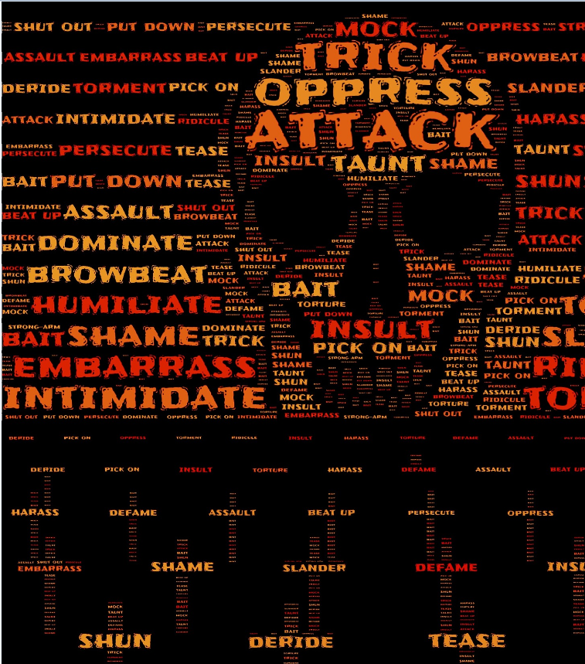
OUR FOCUS ON WORKPLACE VIOLENCE PREVENTION
A complete and layered approach to include:
Prevention
Threat Assessment
Planning
Training

Slide 10
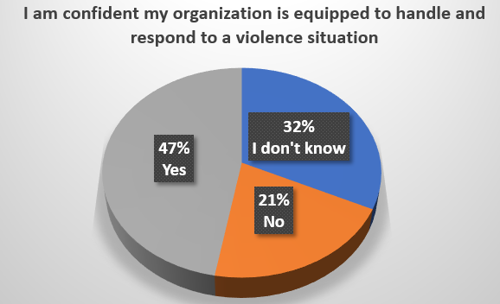
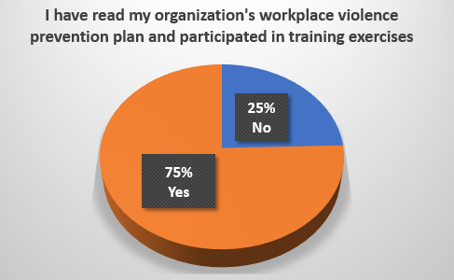
WE ASKED

Slide 11
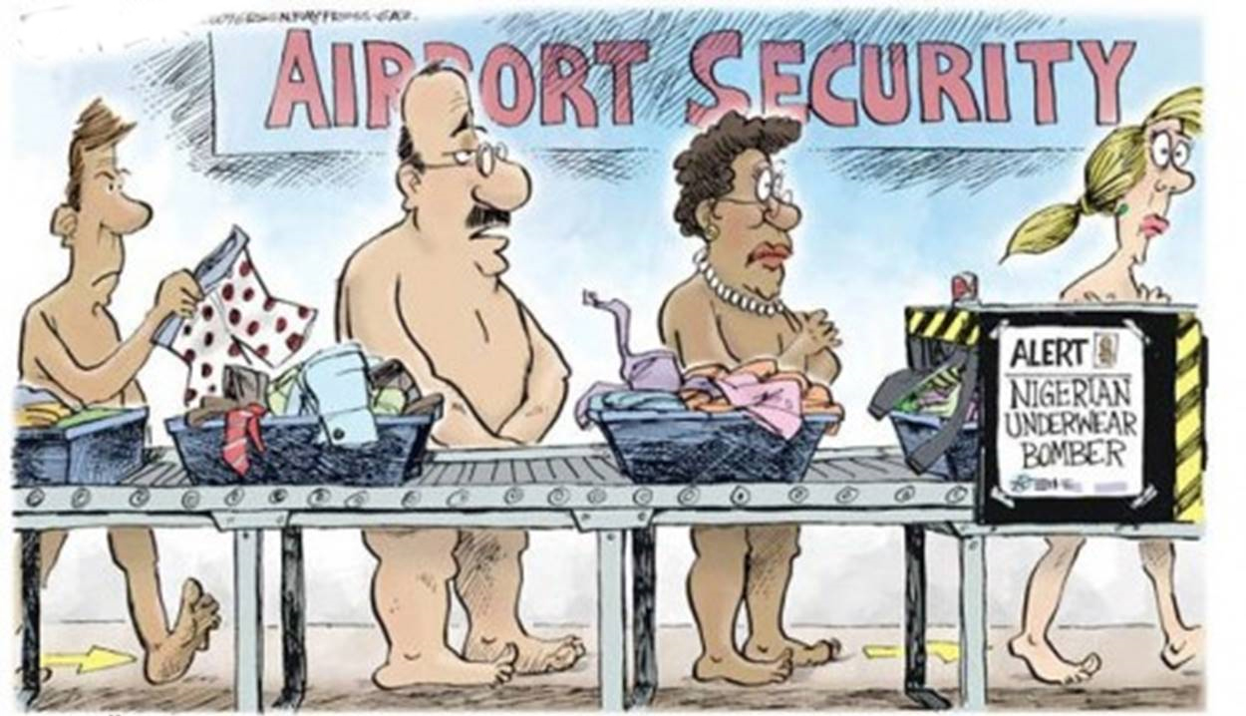
BARRIERS TO PREPARATION
1. Cost
2. Inconvenience
3. Aesthetics
4. Belief

Slide 12
PROCESS

Slide 13
Site Assessment

Slide 14
Emergency Response Plan

Slide 15
PREVENTION
Layered approach
Active Shooters walk a path
Threat Assessment
Connecting the dots

Slide 16
BEHAVIORS OF CONCERN
Difficulty getting along with others
Direct threats
Injustice Collectors
Personal life stress
Overreaction to changes
Obsession or interest in attacks
Paranoia
Depression or Suicidal
Anger issues
Access to weapons
Evidence of radicalization
Gathering weapons and ammo
Increased target practicing
Recent real or perceived loss
History of stalking or harassment
Grooming changes
Isolation
Leakage or Veiled Threats
Notes:
Almost universally violent offenders have had a problem getting along with others in the workplace.
Although direct threats are not necessary they should absolutely be taken seriously
Injustice collectors are looking for things people have done to them. See injustice in most things done to them and do not take any personal responsibility for failings. World is out to get them and they wont put up with it. Vester Flanagan wrote a complaint letter to a restaurant because a waitress said “Have a nice day” instead of thank you. LA Police shooter Chris Dorner spoke of being made fun of in the 3rd grade and remembered the student and principals name. Vester Flanagan blamed every event real or made up on others even blamed his former employer when he killed his own cats.
Recent firing from a job, loss of relationship, death of close family member.
Feel they are being singled out despite evidence to the contrary. Omar Thornton was stealing but felt he was fired for racist reasons.

Slide 17
BEHAVIORAL RISK THREAT ASSESSMENT
Identify / Intake
Categorization
Screening
Notes:
Almost universally violent offenders have had a problem getting along with others in the workplace.
Although direct threats are not necessary they should absolutely be taken seriously
Injustice collectors are looking for things people have done to them. See injustice in most things done to them and do not take any personal responsibility for failings. World is out to get them and they wont put up with it. Vester Flanagan wrote a complaint letter to a restaurant because a waitress said “Have a nice day” instead of thank you. LA Police shooter Chris Dorner spoke of being made fun of in the 3rd grade and remembered the student and principals name. Vester Flanagan blamed every event real or made up on others even blamed his former employer when he killed his own cats.
Recent firing from a job, loss of relationship, death of close family member.
Feel they are being singled out despite evidence to the contrary. Omar Thornton was stealing but felt he was fired for racist reasons.

Slide 18
CRITICAL INCIDENT RESPONSE
Testing of protocols
Physiology
Simulation
Training is perishable

Slide 19
3 STAGES OF CRITICAL INCIDENT RESPONSE
Sense Danger
Evaluate Response Options
Commit to Action
Notes:
Process each person goes thru in responding to danger.

Slide 20
SENSE DANGER
Denial
Normalcy Bias
Social Proof
Underestimating Severity
Notes:
Church shooting
9/11
Fire crackers
Car backfire
We want to be part of the group not an outlier
People don’t want to overreact.
Nightclub fire video
Kennedy assassination

Slide 21
EVALUATE RESPONSE OPTIONS
PRE-INCIDENT ACTIVITIES
Training and Testing
Mental scripting
Knowing your environment
Notes:
Drills
Pre-Flight safety briefing

Slide 22
ACTIVE SHOOTER RESPONSE
Escape
Secure
Confront
Notes:
Concept based
Not a linear approach

Slide 23
Commit To Action
Commitment
Conviction
Confidence
DO SOMETHING!
Notes:
Training
Practice
Drills
Mental Scripting
Slow is smooth, smooth is fast
Aggressive, conviction, commitment

Slide 24
THE SOLUTION TO WORKPLACE VIOLENCE
Awareness Training
(AT)
Anonymous Reporting
(AR)
Media Monitoring
(MM)
Violence Response
(VR)
Centralized Information
Warehouse
(CW)
Management System
(MS)
Administrator on Duty
(AoD)
Behavioral
Assessment Team
(SBAT)
Risk Categorization Matrix
(RM)

Slide 25
WHAT’S
NEXT?
DOWNLOAD
Access resources at Firestorm.com/briefs along with a variety of other no-fee resources.
ASSESS
Self-Assessment for your business
COMMIT
Develop and commit to a preparedness roadmap.

Slide 26
Questions?

Slide 27
THANK YOU
Missan Eido
meido@firestorm.com
www.firestorm.com
(512) 507-6930

